Slide 1
The Hundred Schools of Thought
Title
Reporters：Group 5
Date：2021-12-09

Slide 2
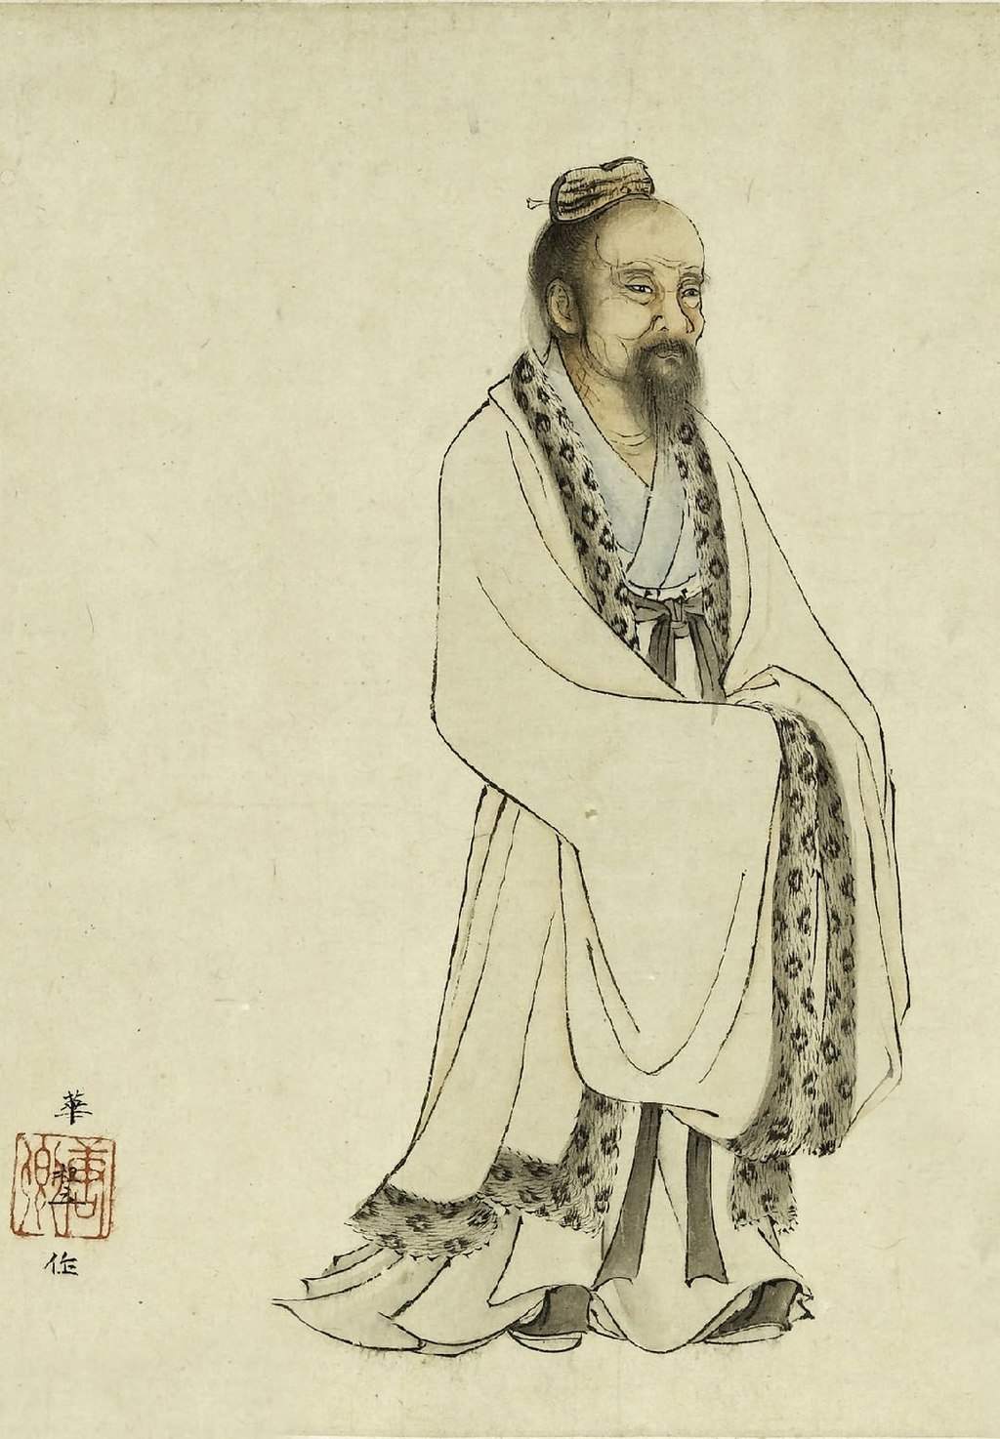
Section: xx
Taoism：Chuang Tzu
Introduction
Writings
Influence
Biological evolution
Reporter：WYM

Slide 3
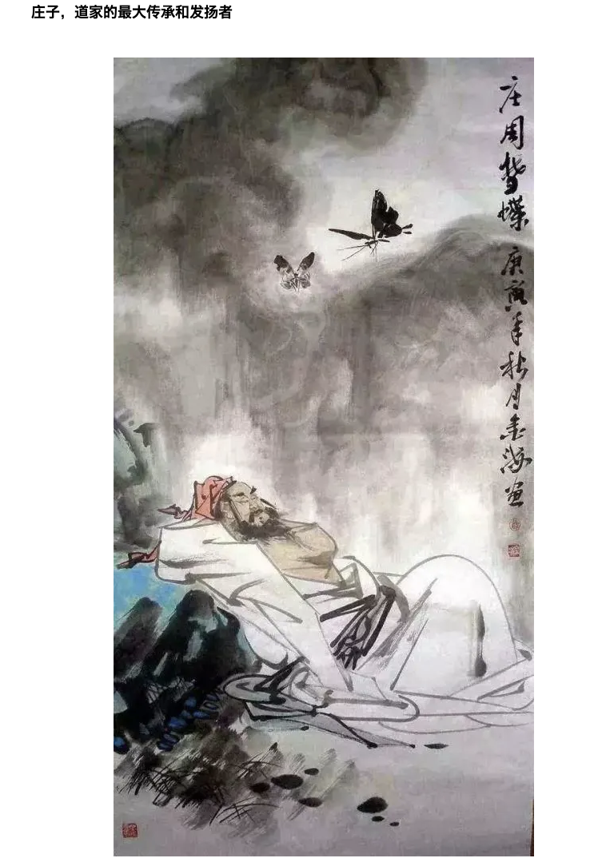
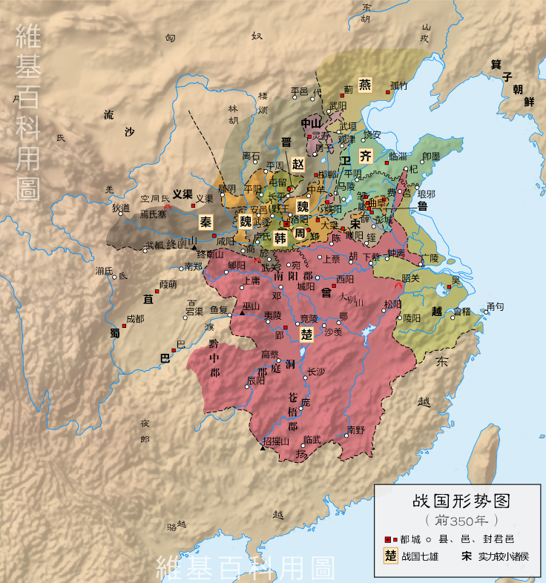
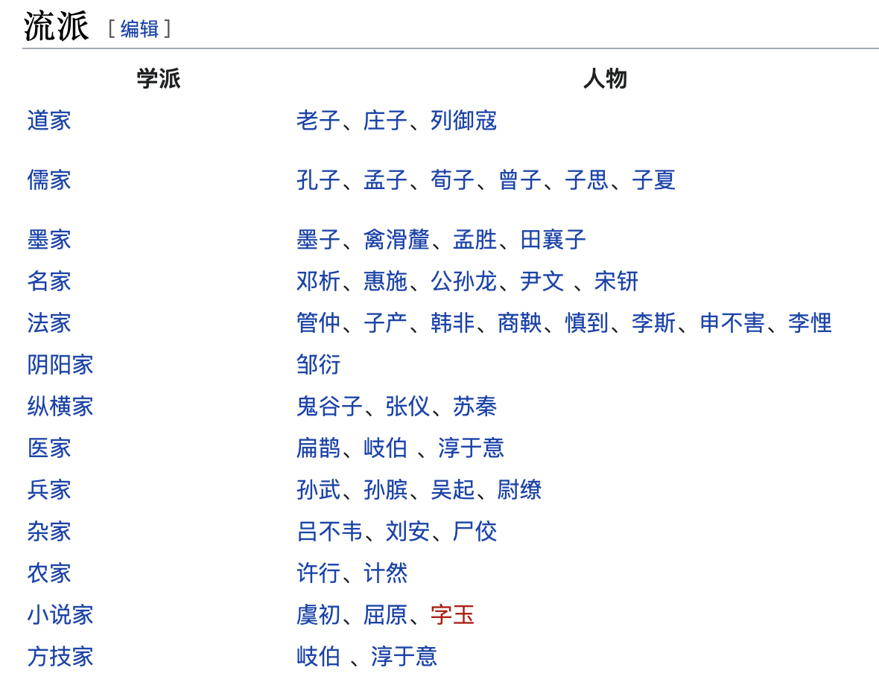
Chuang Tzu
1. Introduction
Chinese philosopher
The 4th century BC——Warring States period
One of the foundational texts of Taoism

Slide 4
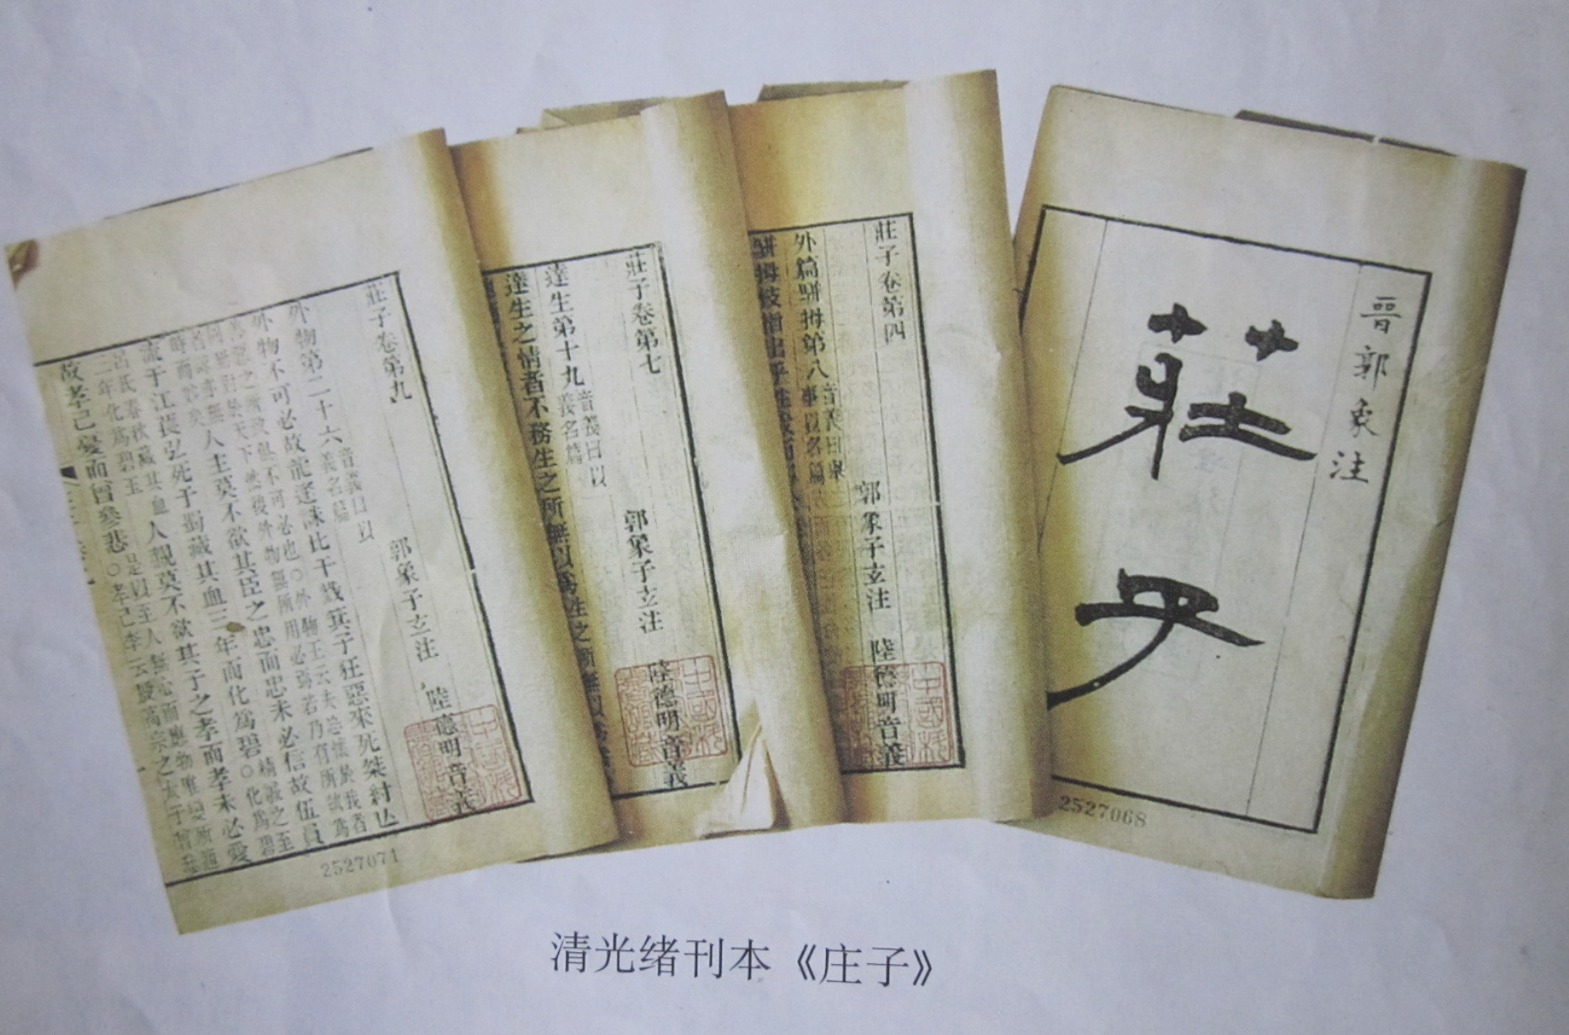
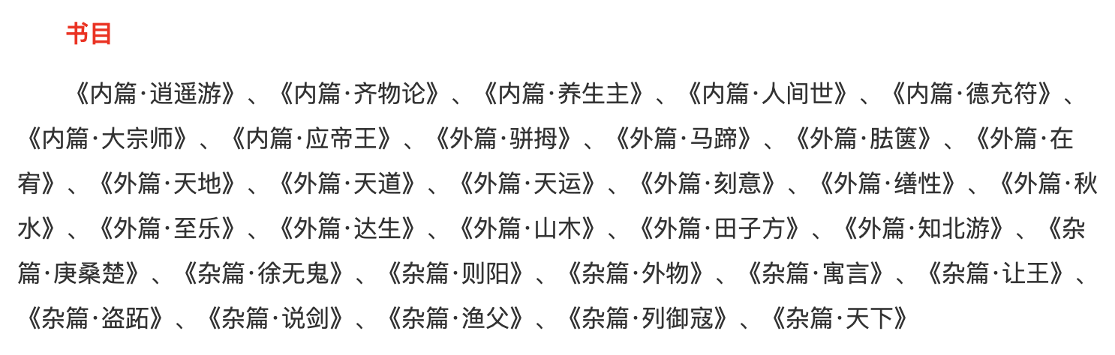
Chuang Tzu
2. Writings
Zhuangzi：33 chapters, divided into three parts.
A Happy Excursion：Show the realm and ideals of Zhuangzi.
In the northern ocean there is a fish, called the k’un, I do not know how many thousand li in size. This k’un changes into a bird, called the p’eng. Its back is I do not know how many thousand li in breadth. When it is moved, it flies, its wings obscuring the sky like clouds.
北冥有鱼，其名曰鲲。鲲之大，不知其几千里也。化而为鸟，其名而鹏，鹏之背，不知其几千里也；怒而飞，其翼若垂天之云。
——《逍遥游》

Slide 5

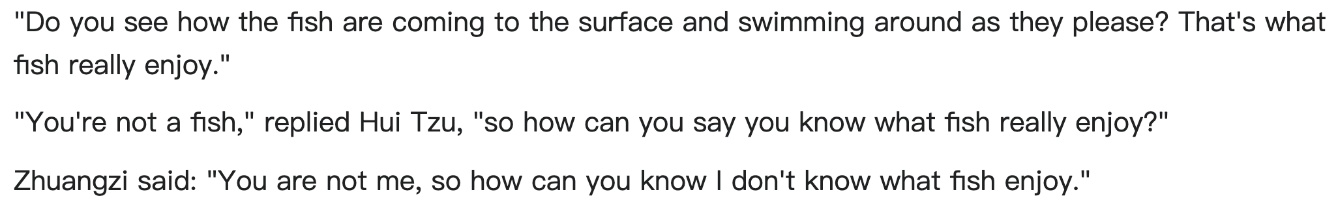
Chuang Tzu
3. Influence
The influenced thinking far beyond East Asia：
The German philosopher Martin Buber translated his texts in 1910.
In 1930, Martin Heidegger asked for Buber's translation of Zhuangzi after his Bremen speech "On the Essence of Truth".
The historian of ideas Dag Herbjørnsrud concludes: "It may therefore be difficult to say where the philosophies of Lao Tzu and Zhuangzi end and where the most influential German thinking of the twentieth century starts [...]"

Slide 6
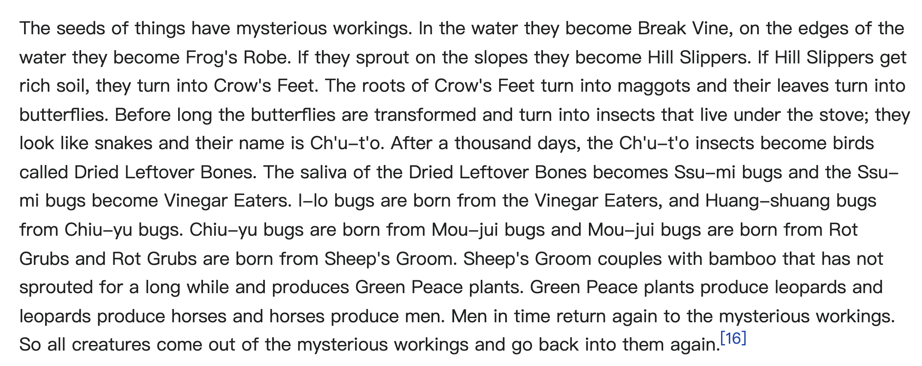

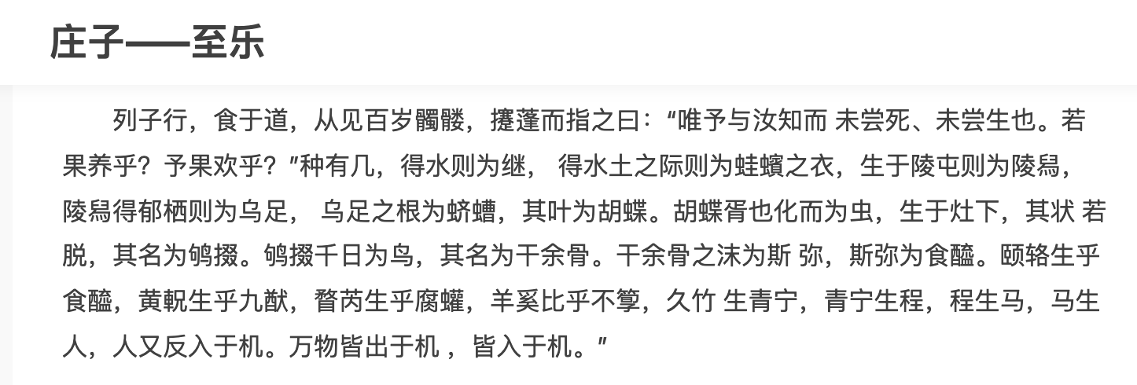
Chuang Tzu
4. Biological evolution
Chinese forerunner of evolution：
Zhuangzi described the transmutation of species(translated by Burton Watson).
The 20th century Chinese philosopher and essayist Hu Shih considered Zhuangzi a Chinese forerunner of evolution.

